Slide 1
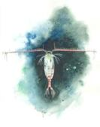
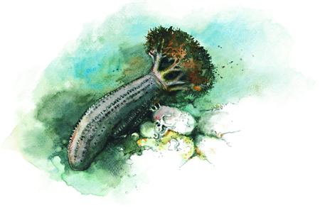
Predict Greenland Halibut Age reading Otoliths with Convolutional Neural Networks
Endre Moen
Mars 2018
Maskinlærings-seminar

Slide 2
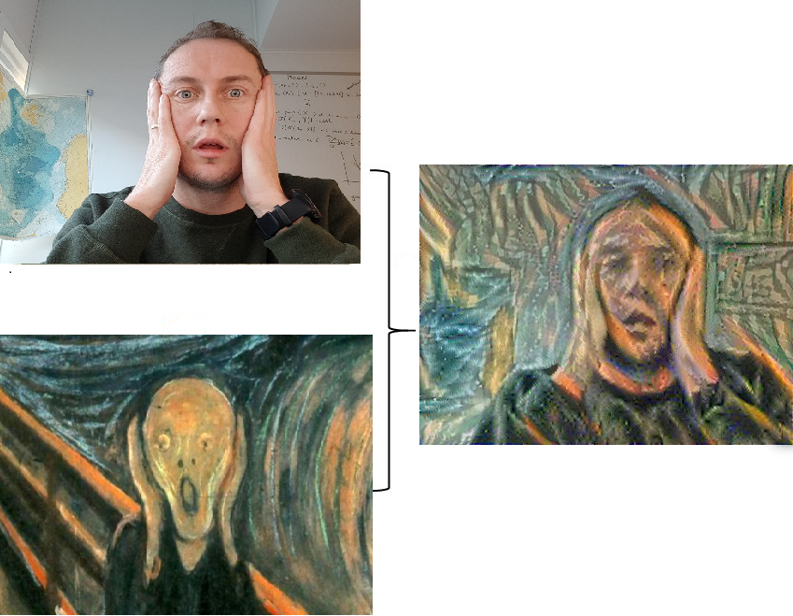
Who am I
Software engineer at Norwegian Marine Datacenter (NMD)
Computer Science
Notes:
2 slides, Meg, NMD, Instituttet, Web-utvikler perspektiv

Slide 3
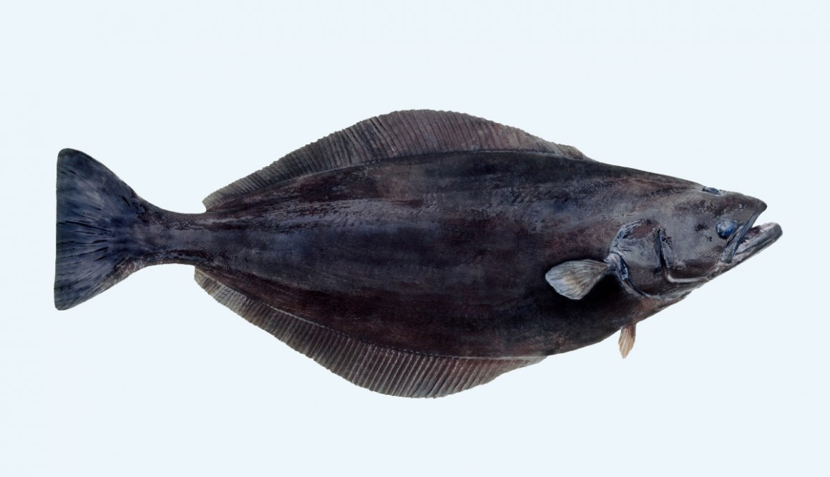
Otoliths: Greenland Halibut (Ørestein:Blåkveite)

Slide 4
Raw-data format
-Age- 11
8 5

Slide 5
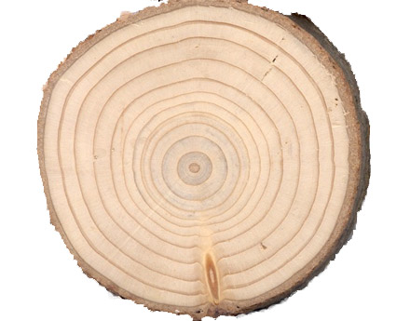
Tree rings

Slide 6
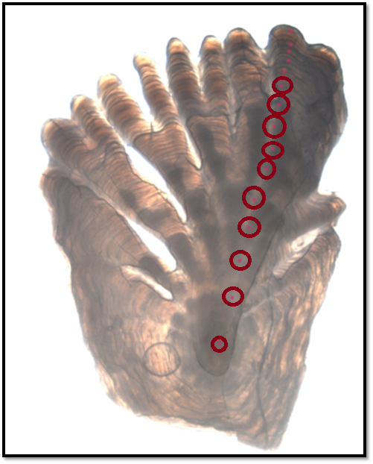
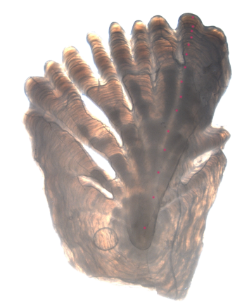
14 years

Slide 7
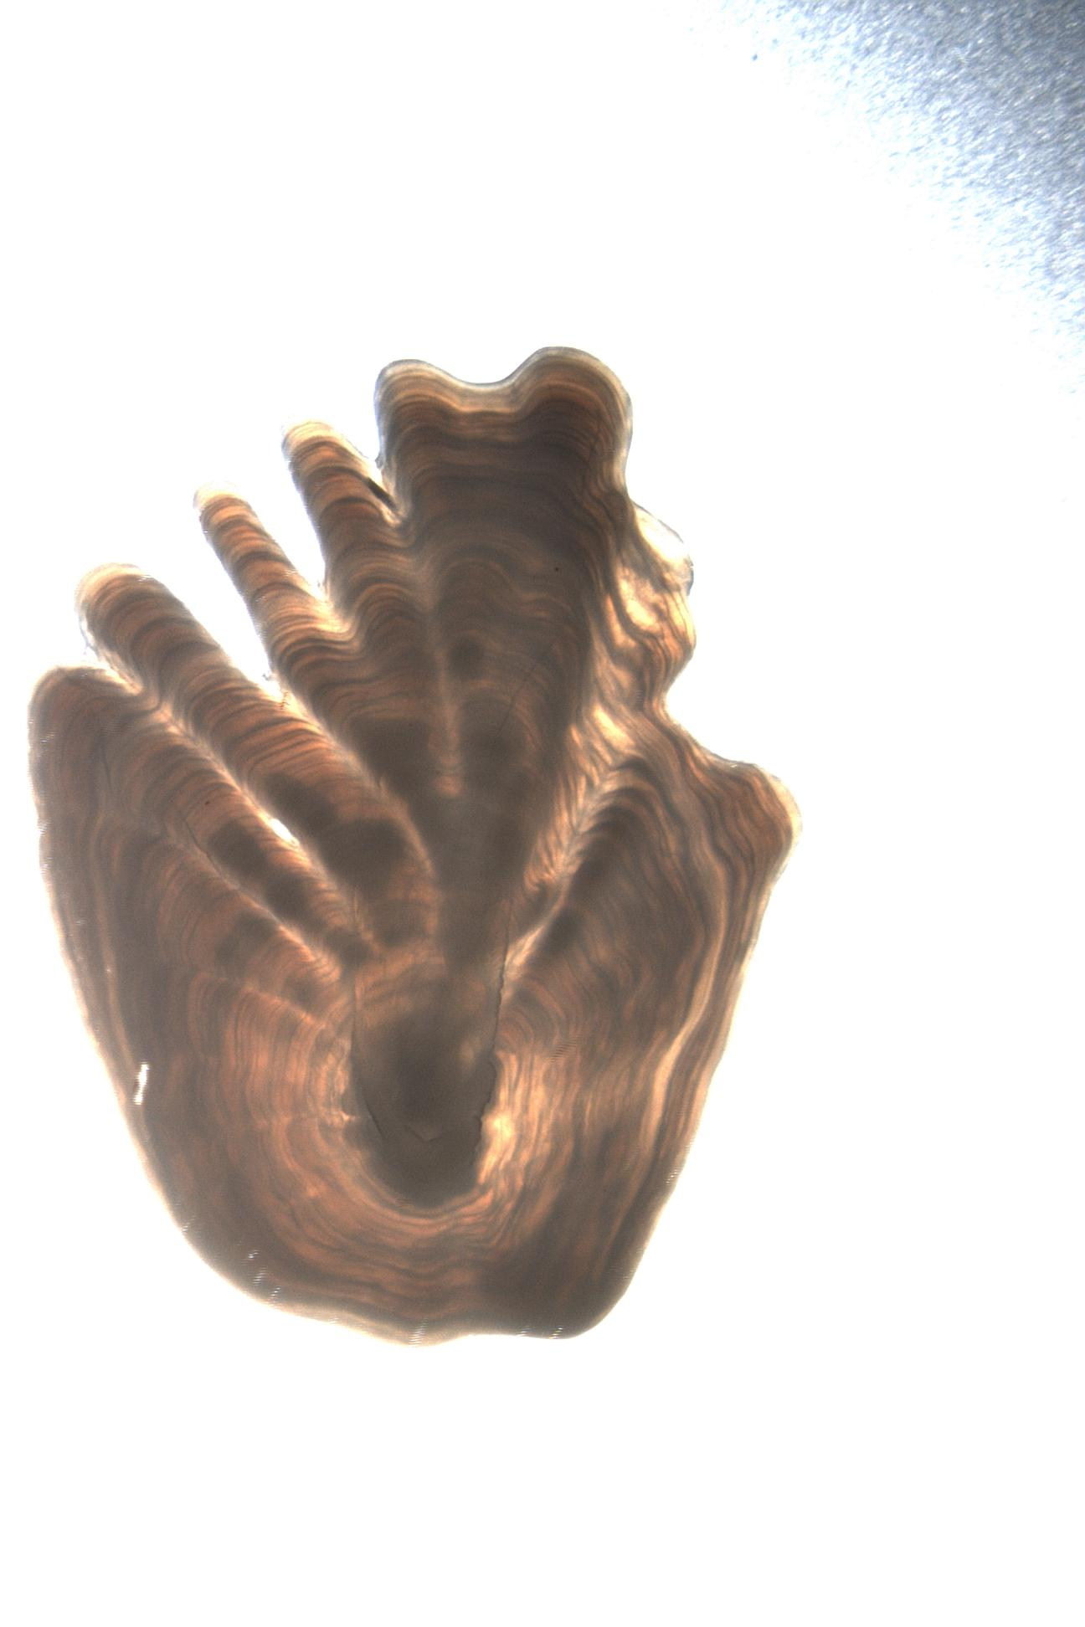
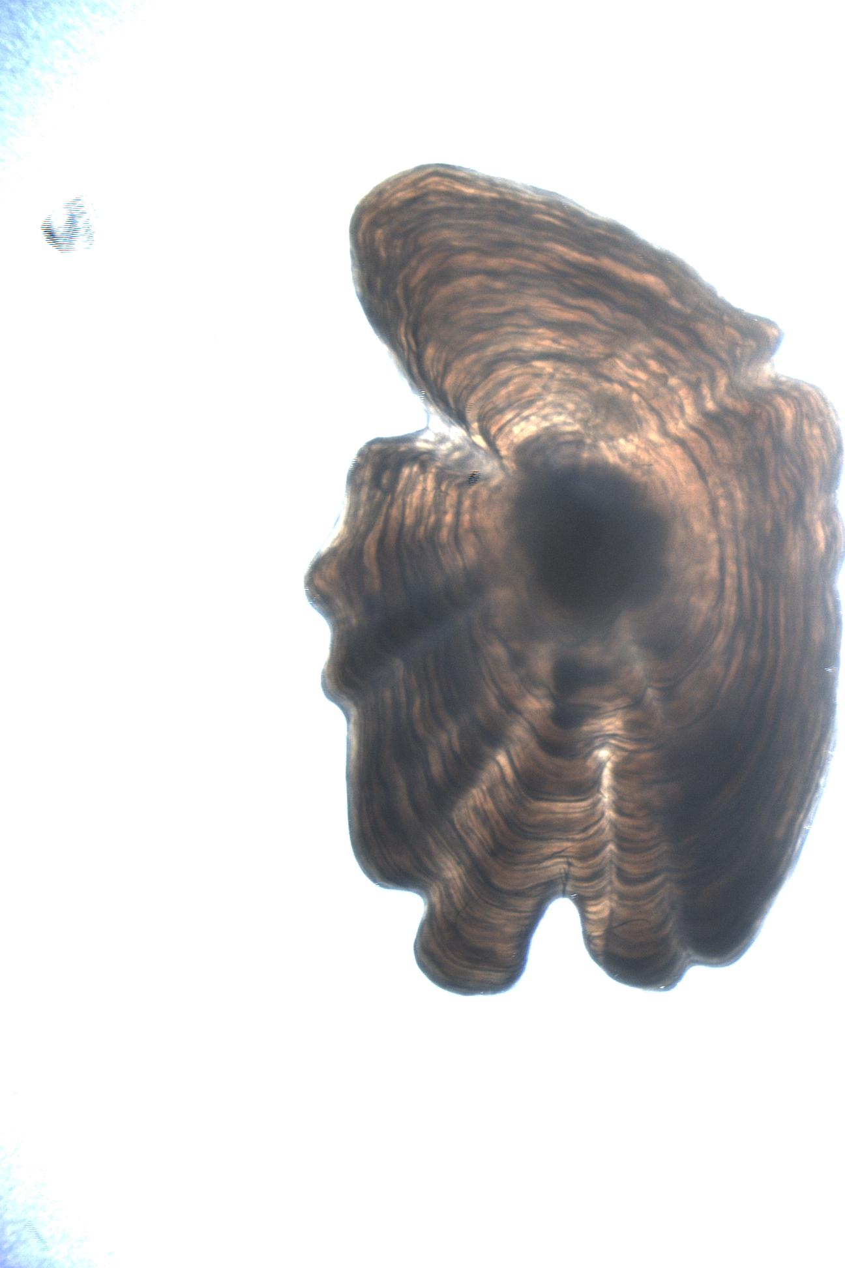
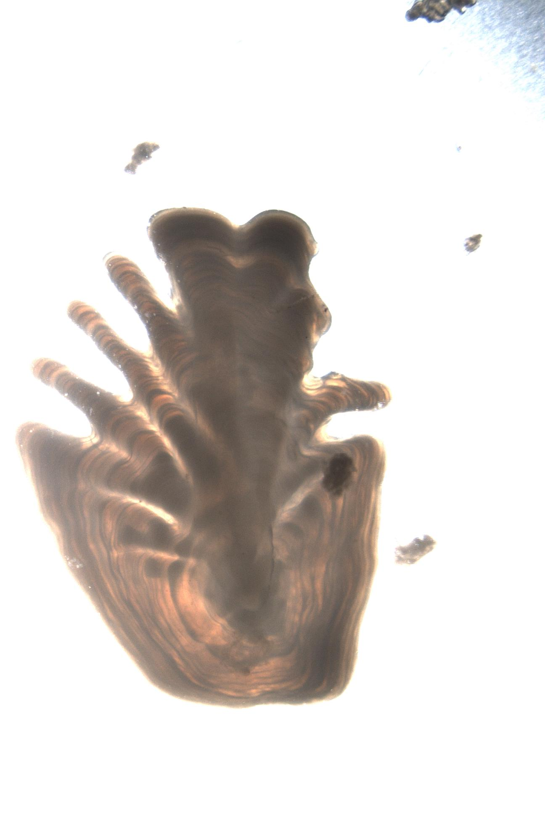
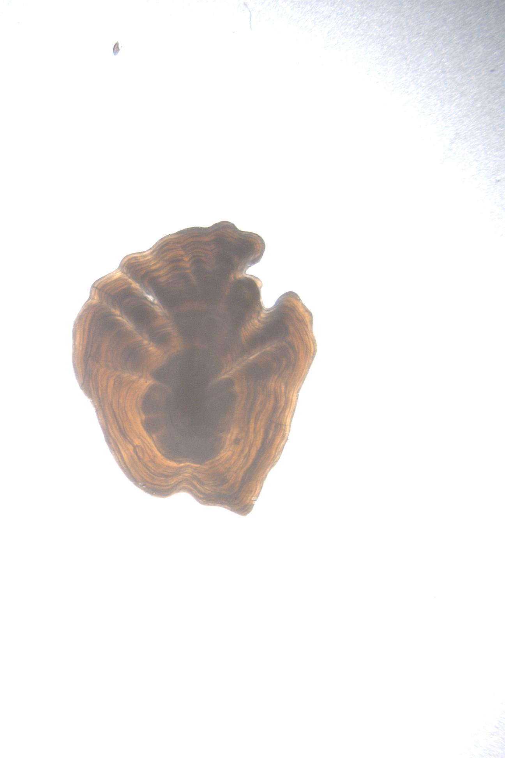
Predicted: 11.17,11.03,12.97,5.81 Age by Expert:13, 15, 13, 6
Mean Squared Error (MSE) = 4.1

Slide 8
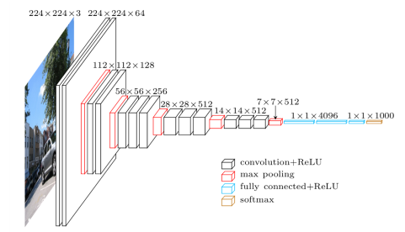
Convolutional Neural Network
Using Keras, Tensorflow, python

Slide 9
Convolutional Neural Network
Edge detection
Padding
Stride
Pooling
Inception (v3)
Residual Neural network (resnet50, resnet152)

Slide 10
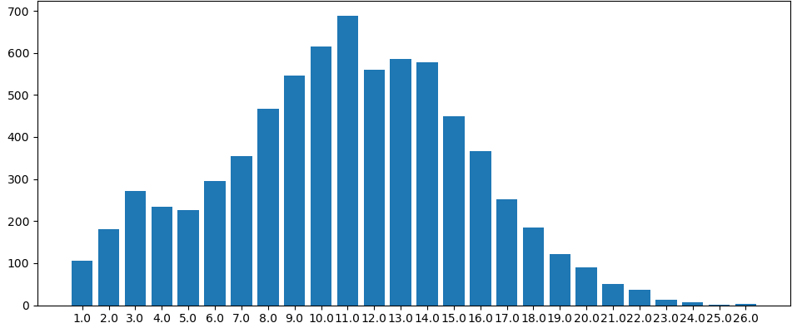
Dataset (ca 7000 images)

Slide 11
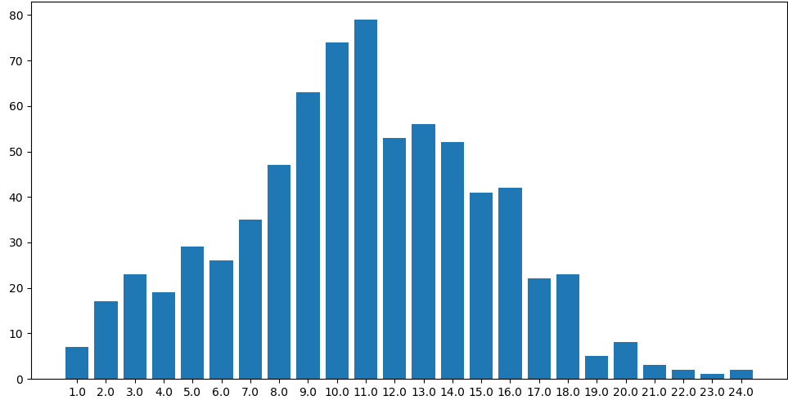
Validation set (ca 10%)

Slide 12
Data Augmentation
Rotate image 360 degrees
Reflect image
The age is invariant to rotation/ reflection
Augmented: 7000*360*2 = 5 million possibilities

Slide 13
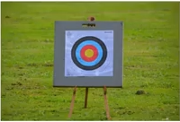
Cost function
Coefficient of Variation when 2 experts read otoliths: ca 5-10%
Experts as Proxy for Bayes optimal Error rate (best we can hope for – supervised learning)
Mean of dataset: 10.88
MSE(mean squared Error): ca 1.0 for CNN
MSE: ca 3.0
=> CoV: 17%

Slide 14
Approaches
Format Raw Data - split images
RGB images or transformed to grayscale
small model custom model
InceptionV3
ResNet50 and ResNet152
Tune hyper parameters:
image resolution,
optimizer (rmsprop, sgd, adam),
batch size, and learning rate

Slide 15
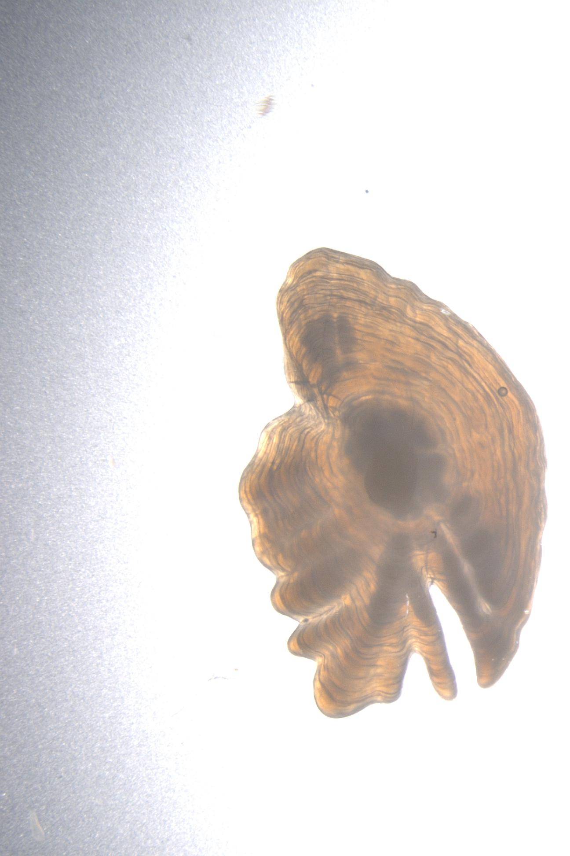
Image transformation with Geospatial Data Abstraction Library (GDAL) using Hillshading algorithm

Slide 16
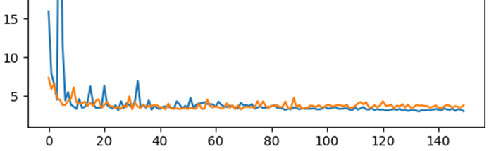
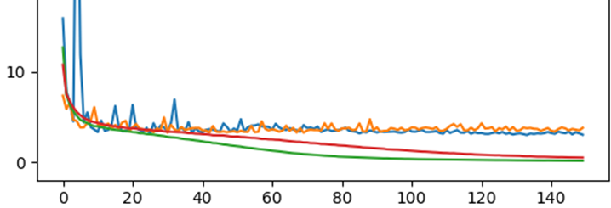
Validation MSE:Inception(Blue, MSE: 3.0), ResNet(orange, MSE: 3.1) (optimizer: Adam, ImageAugmentation: rotation, reflection)
Y-axis: MSE
X-axis:Epochs
With training MSE

Slide 17
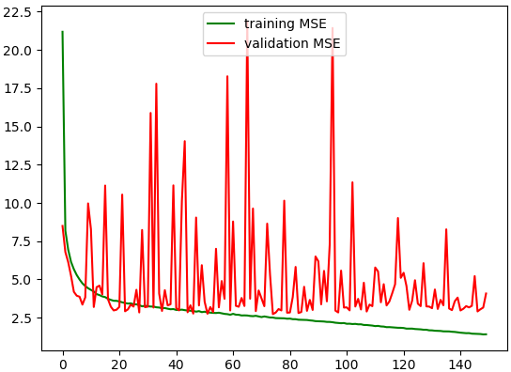
Inception with RGB images (best MSE:2.7)
Y-axis: MSE
X-axis:Epochs

Slide 18
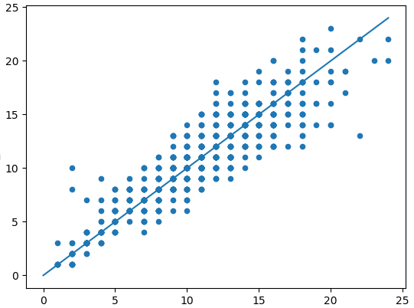
X-axis: Actual age, Y-axis:Prediction
Ŷ - predicted
Expert Age

Slide 19
New Ideas
Use output of one otolith to look at the pair of otoliths from the same fish – as input to new neural network
K factor index (length/weight) – that says if the fish has been eating well or not
Tune hyperparameters

Slide 20
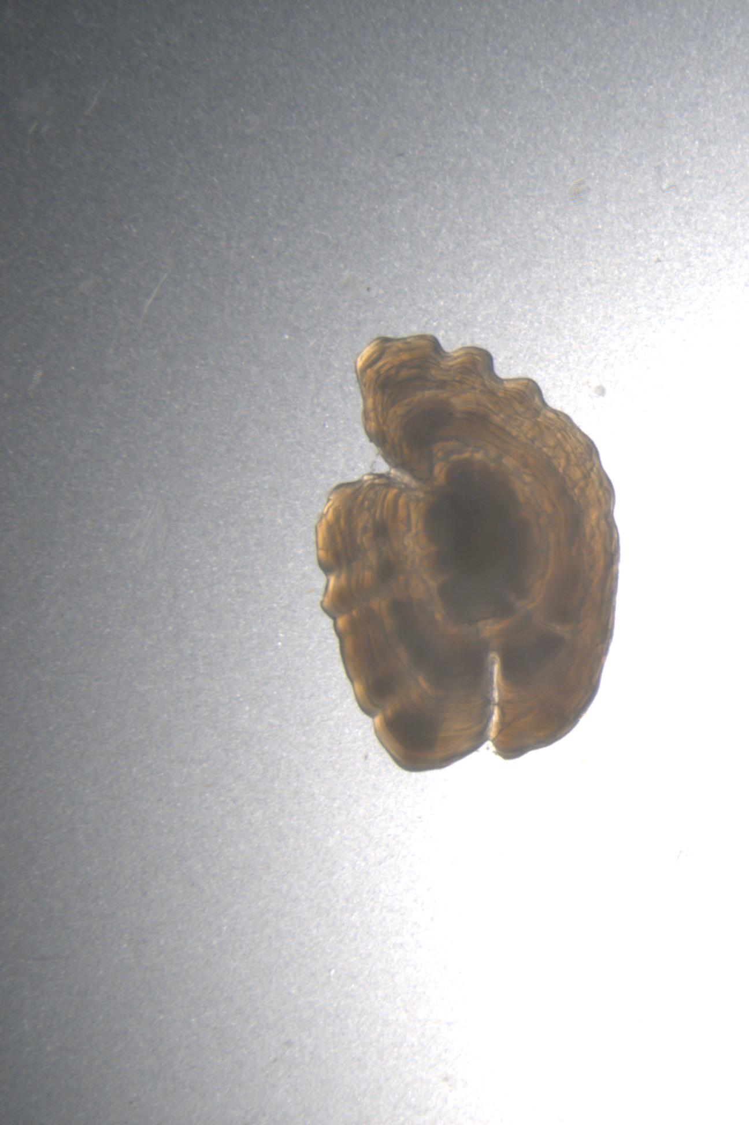
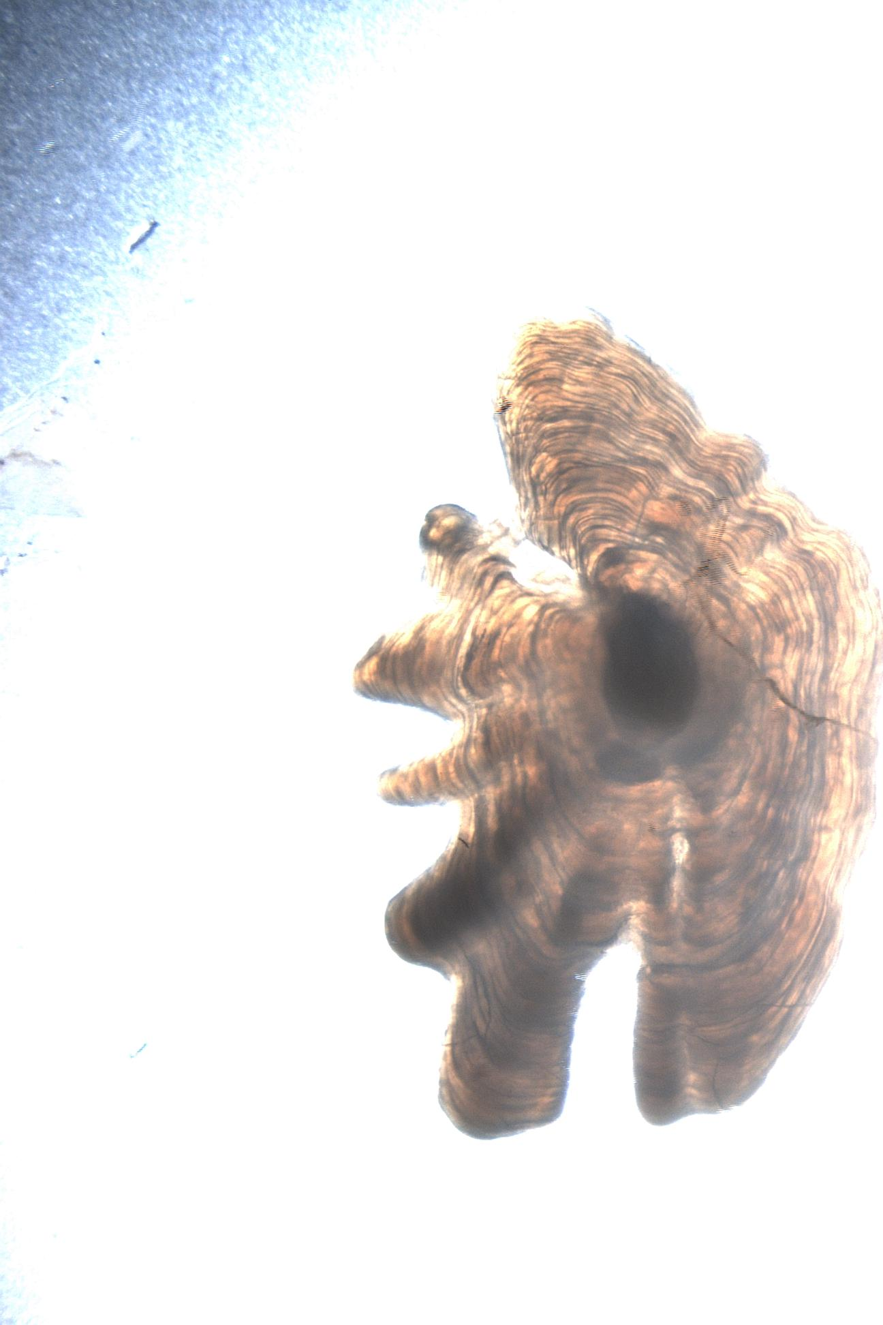
Predicted: 5.39, 11.72, Age by Expert: 4, 12
Any Questions?

